Slide 1

Logging Solution
Requirement: To collect Windows Event Logs of all virtual machines in the existing project and have their retention kept in the AWS cloud storage(s3).

Slide 2
Requirement Gathering
1. Usecase: Is the usecase only for compliance and retention? If not does the customer needs visualizations based on logs, alerting based on logs etc
2. Logs retention: Upto what time the logs are actively accessed/looked into? Total retention of logs? 3. Read Access for logs to be limited to which group/individual/team? 4. Time interval acceptable for delay in flushing the logs from server to S3?
5. logs to be copied to S3 in central account for the organisation?

Slide 3
Possible Solutions
Couple of possible solutions amongst diff ways to achieve this requirement is as below: 1. Kinesis Agent Kinesis agent on windows to stream logs to Kinesis Firehose and Firehose will be configured with S3 as destination
2. Cloudwatch Agent
Cloudwatch agent on windows to log to Cloudwatch log groups. Log group to have a log subscription attached to it that further sends log to Kinesis Firehose that will eventually push the logs to S3.
(Another possible solution is using Fluent-bit on windows and configure fluent-bit to send logs to S3).

Slide 4
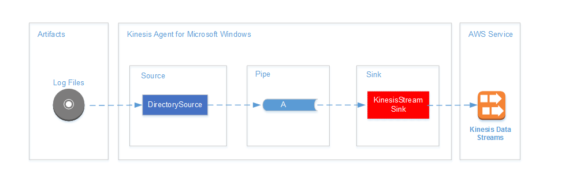
Kinesis Agent for Windows

Slide 5
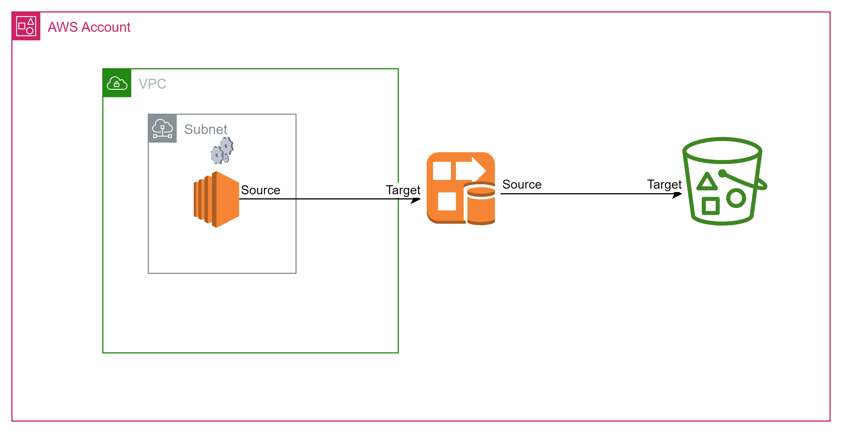
High Level Diagram

Slide 6
Important Points in IAC!
Restrict access to S3 where logs are stored.
Enable data at rest encryption for S3 bucket.
Ensure log integrity by enabling object lock(worm) on S3 bucket.
Configure access logging for S3 bucket.
Configure Lifecycle policy for S3 to save costs and enable retention.
Ensure Kinesis Firehose is allowed access only from EC2 Profile that is attached to your servers.
Ensure Kinesis Firehose is using server side encryption.

Slide 7
Terraform code
The code is not yet fully optimal for production workloads. It is more in POC state as of now.

Slide 8
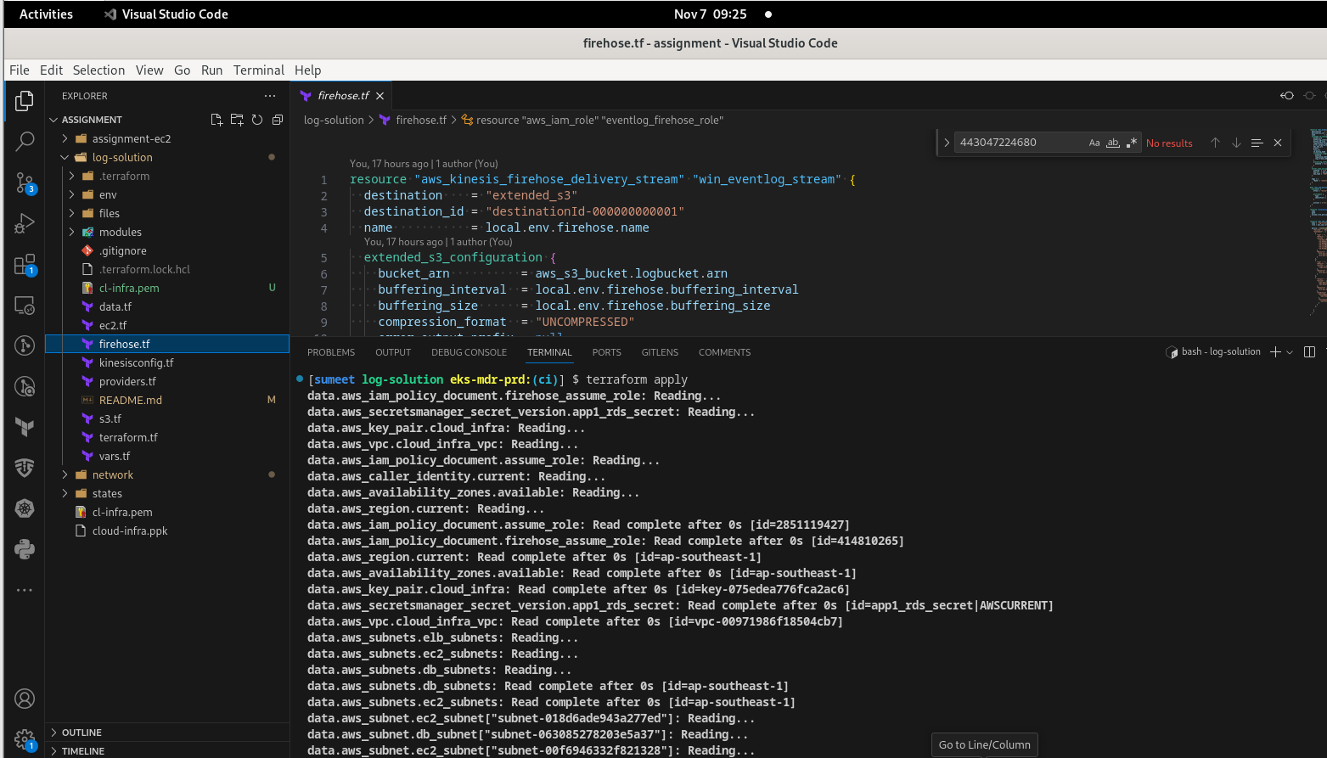

Slide 9
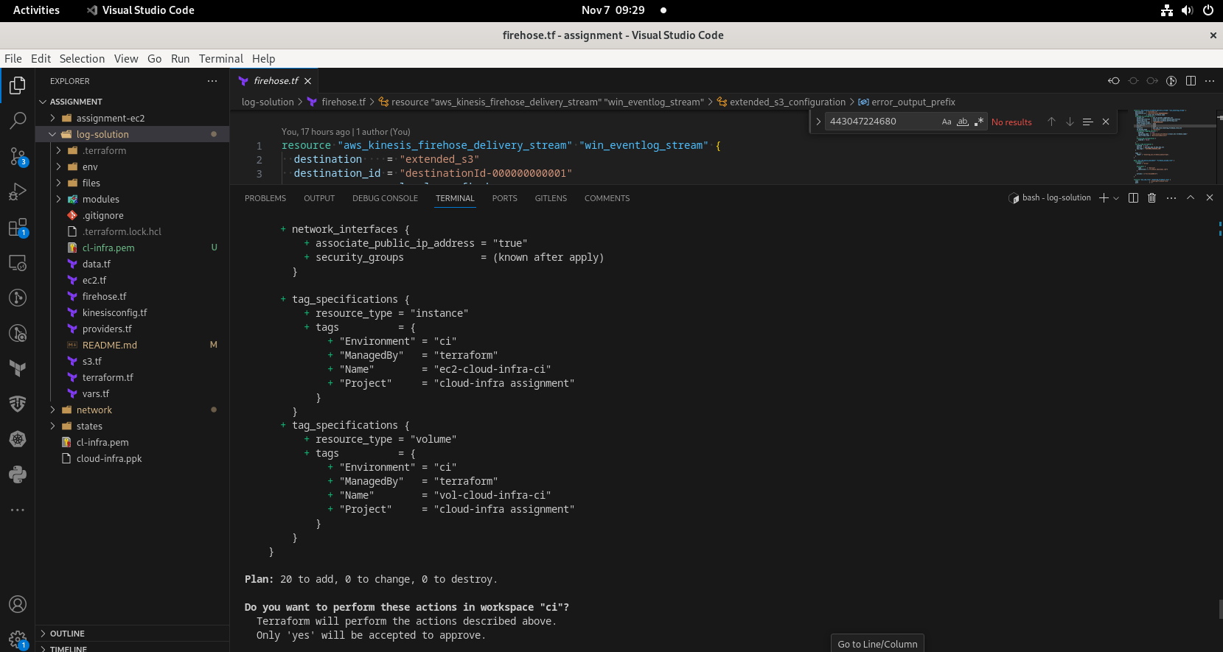

Slide 10
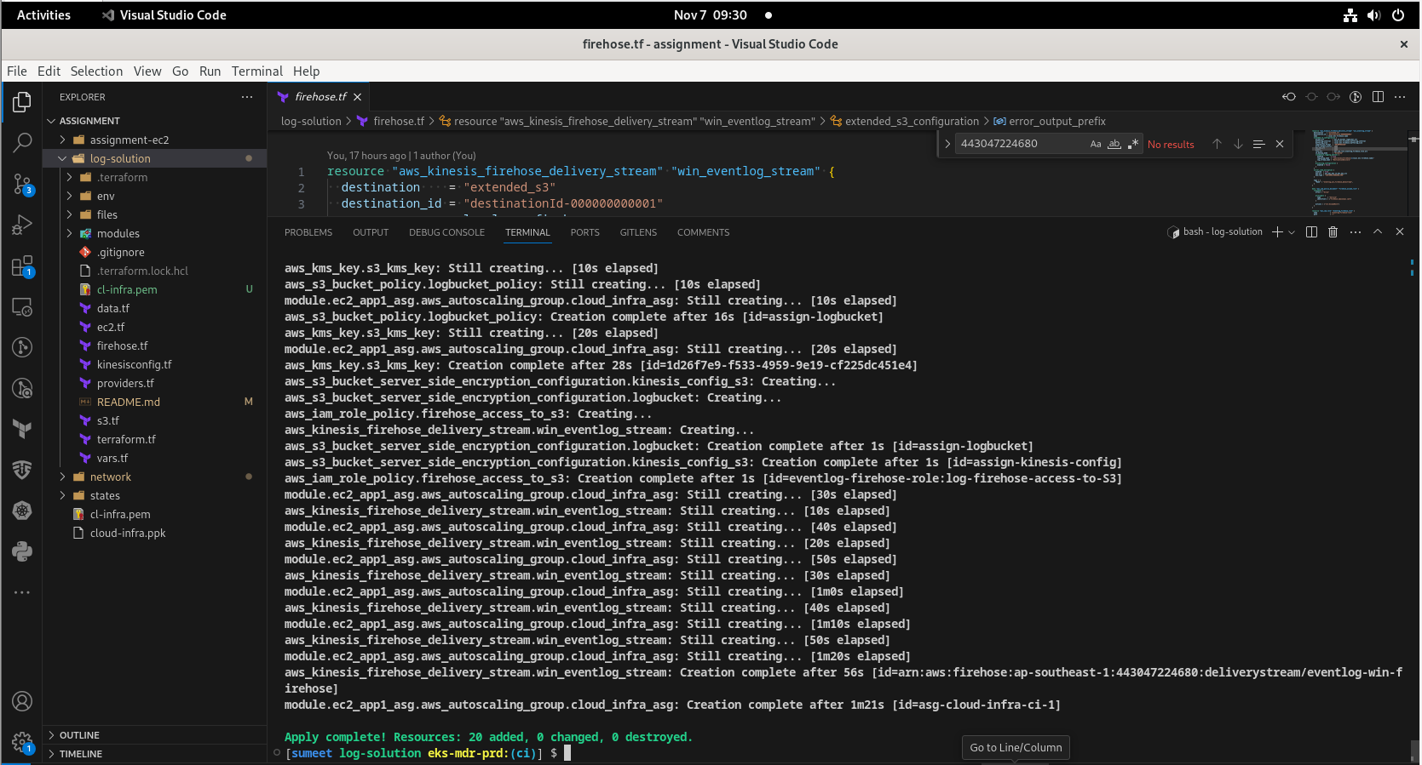

Slide 11
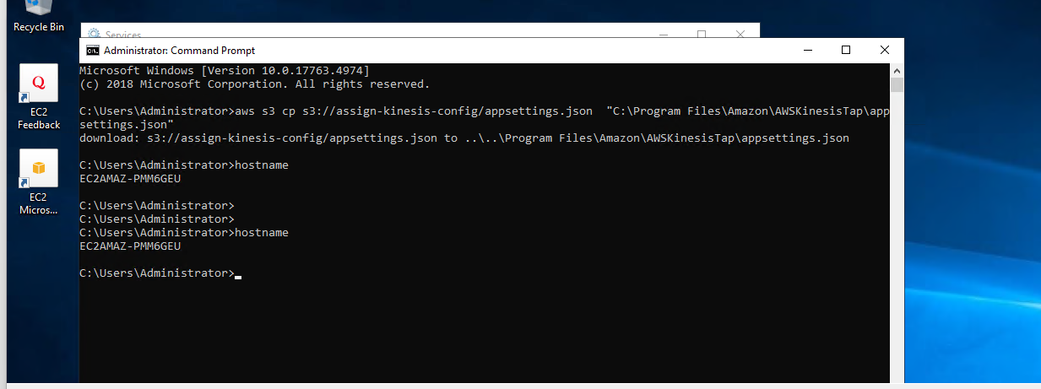
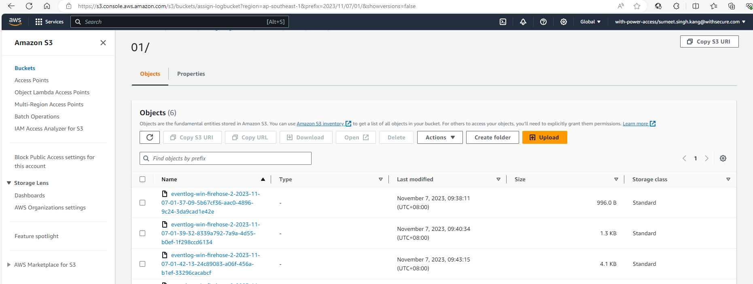

Slide 12
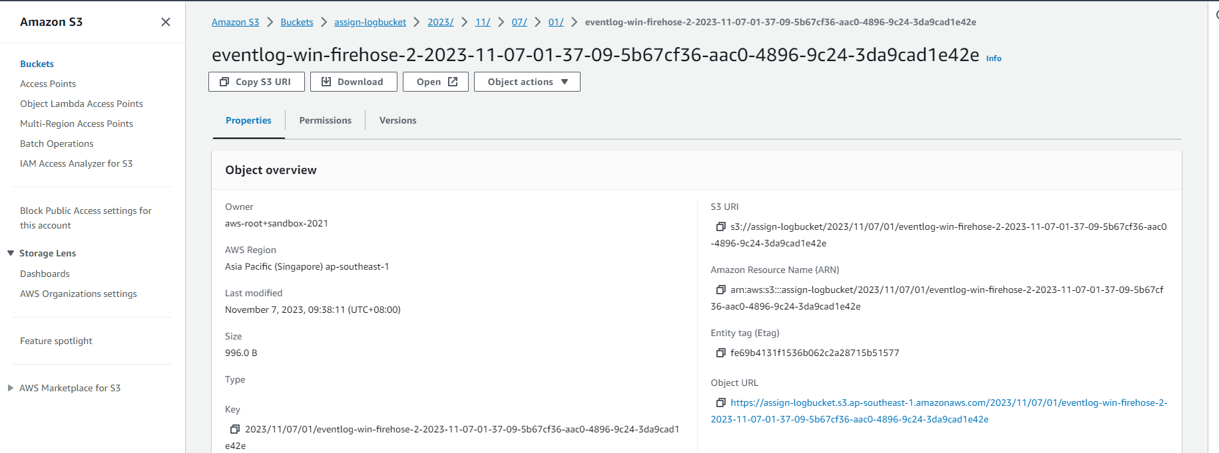
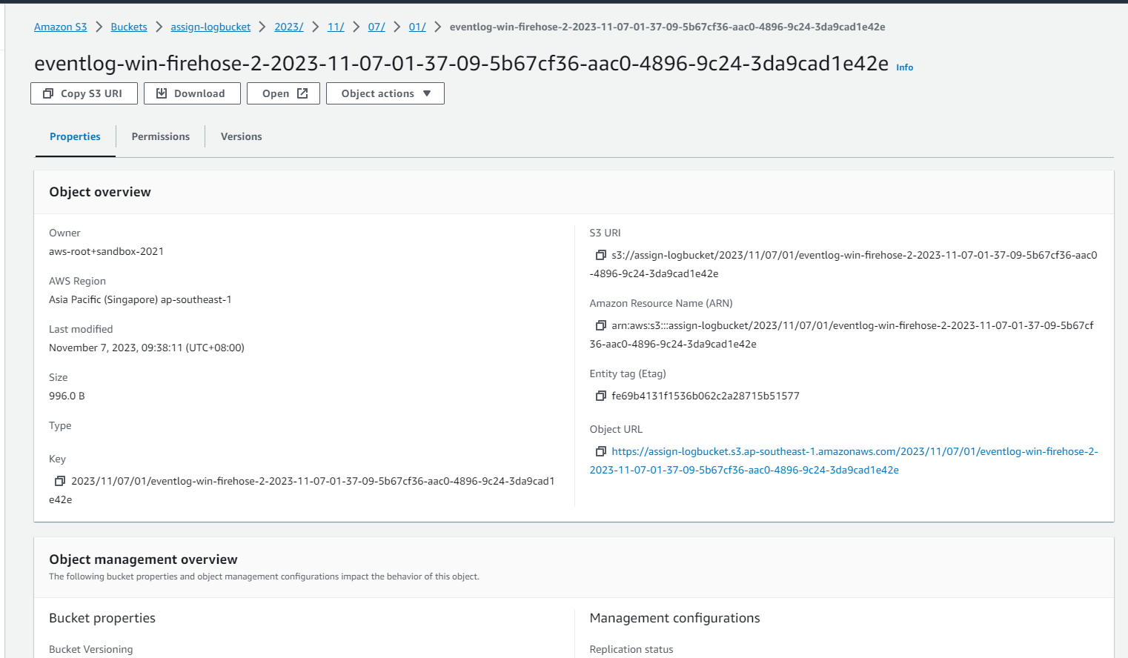

Slide 13
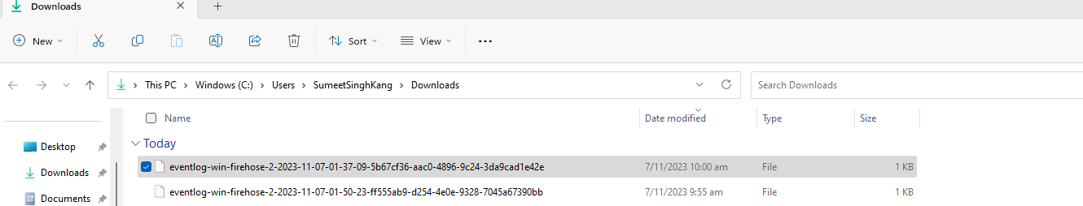
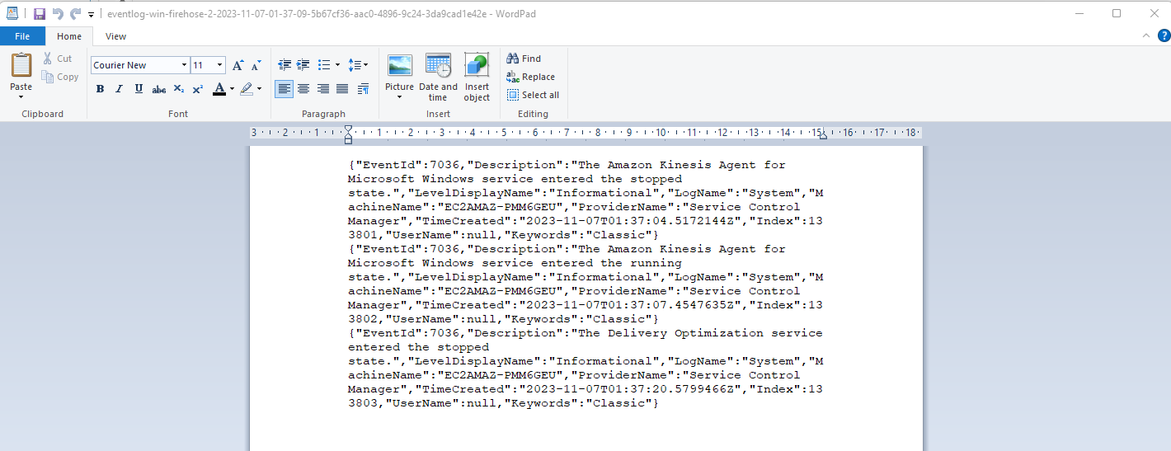

Slide 14
Scaling
Few ways of scaling out on other servers:
For any new EC2 we can either use a custom AMI or user data to set up kinesis agent.
For existing EC2 use SSM to install Kinesis agent and run the powershell script to setup kinesis agent config.

